Slide 1
FROM
IDEA
TO
SUCCESS

Slide 2
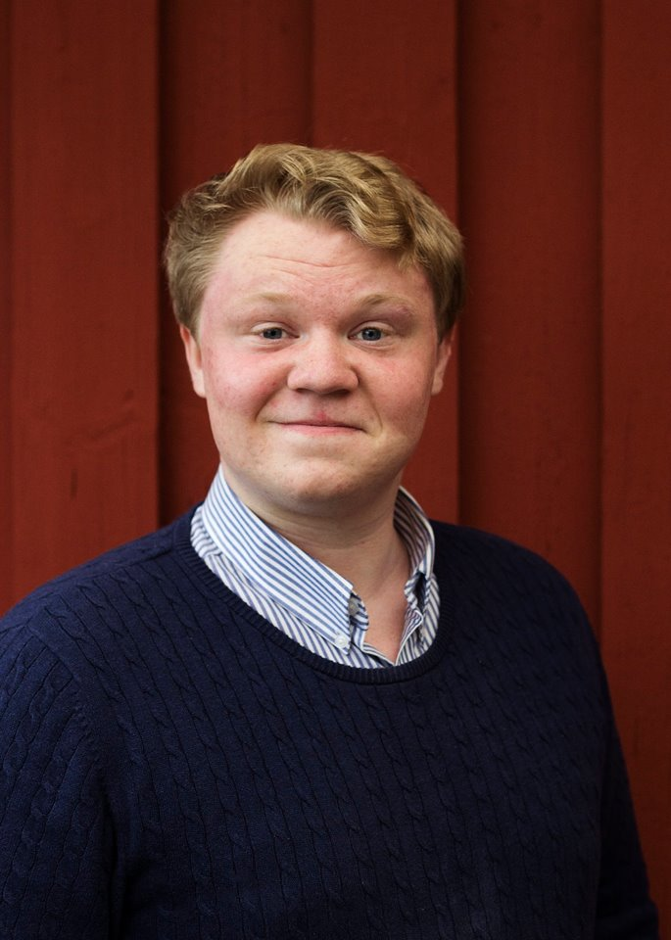
Joakim Stålåker
Project manager

Slide 3
From Idea to Success is a comprehensive project that aims to promote young planning, leadership and organization.
The project is aimed at young people in the Enköping region, mostly people aged 16-22 who live in smaller communities outside the city centre.
The project started in 10th july 2014.

Slide 4
Inspiration days
Youth lead courses in planning, leadership and economy.
Mentorship for young leaders in the non-profit sector.

Slide 5
During the first year of the project…
Around 400 people was involved in the project
8 youth founded local associations

Slide 7
Thanks!
Thanks!
Thanks!
Thanks!
Thanks!
Thanks!
Good Bye!
Contact information
Joakim Stålåker Project manager
Tfn: 072-317 78 78 E-post: joakim.stalaker@viunga.se

