Slide 1



„Europejski Fundusz Rolny na rzecz Rozwoju Obszarów Wiejskich: Europa inwestująca w obszary wiejskie”
Instytucja Zarządzająca Programem Rozwoju Obszarów Wiejskich na lata 2014-2020- Minister Rolnictwa i Rozwoju Wsi. Materiał współfinansowany ze środków Unii Europejskiej w ramach Schematu II Pomocy Technicznej „Krajowa Sieć Obszarów Wiejskich” Programu Rozwoju Obszarów Wiejskich na lata 2014-2020
An example of Polish NRN activities for supporting Bioeconomy Solutions-
12th NRN meeting, Estonia
September 2018

Slide 2

Eutrophication of the Baltic Sea
99.7% of Poland’s land surface is within the catchment of the Baltic Sea.
Protection of waters against pollution of agricultural origin –– farmers are working to reduce (N) and (P) emissions to the sea and to practice sustainable agriculture - initiatives aimed at limiting the flow of agricultural pollution into waters
NRN Action Plan – development of cycle of films
on Modern farming methods, one entitled:
„Preventing water pollution”

Slide 3
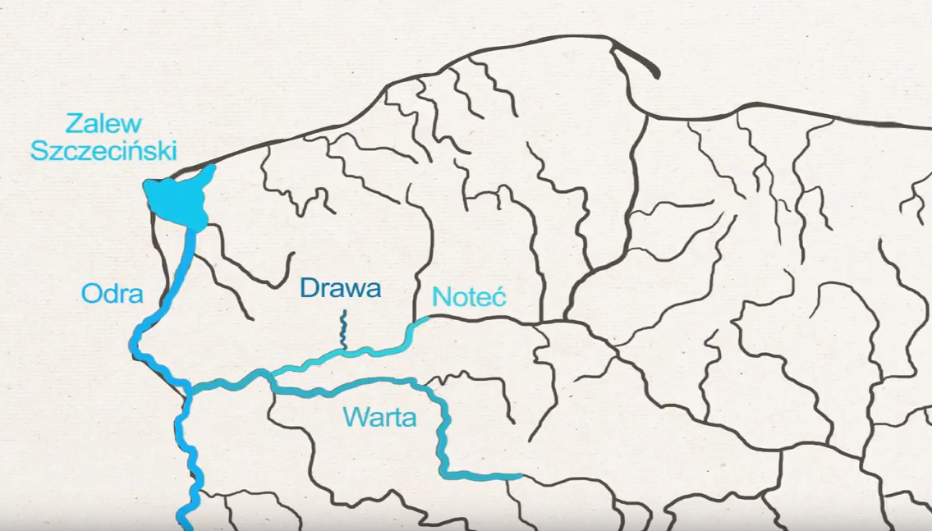
Farm as a good practice
Mrs Elisabeth Reitzig’s farm in Stefanowo (Wielkopolska region in Poland) – 115 hectares of poor soils and 140 cows plus horses.
Organic certification, production of Hereford meat cattle.
Agri-environmental programmes - “extensive farming in meadows and pastures” and “protection of bird breeding habitats” activities.
Located in the Drawa river basin, which flows through Noteć, Warta, Odra rivers and finally into the Baltic Sea.
Baltic Sea

Slide 4
Factors used at a farm that are conducive to stopping the flow of nutrients into the water
Cattle breeding on an extensive, rotational pasture-grazing system,
Proper and optimal management of the weaker soils,
Intensity of cattle stock - 10 large animals per hectare,
Short grazing period,
Meadows are systematically fertilized with the manure of grazing herds,
Silage is not used in the cattle feed,
Shortest edge of pasture section is adjacent to the river,
Natural buffer zones (ponds and trees) alongside water courses at the farm,
Meadows are a buffer for the arable land of neighbouring farms,
Meadows are mowed in August.

Slide 5
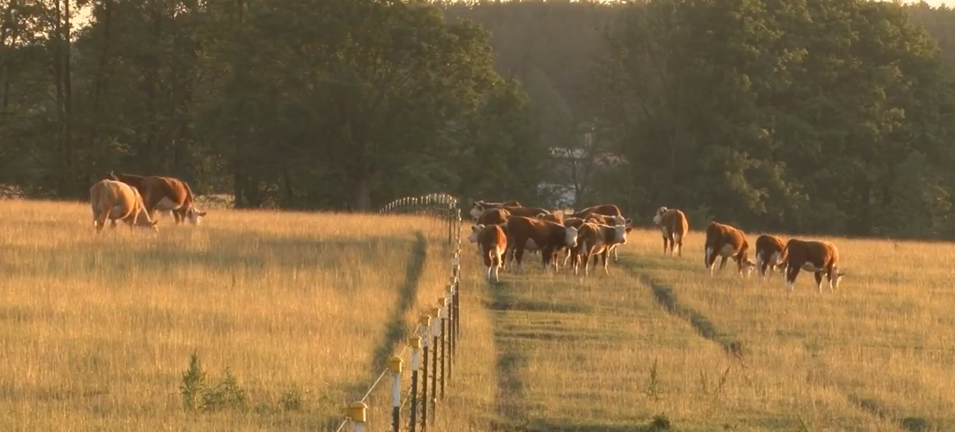
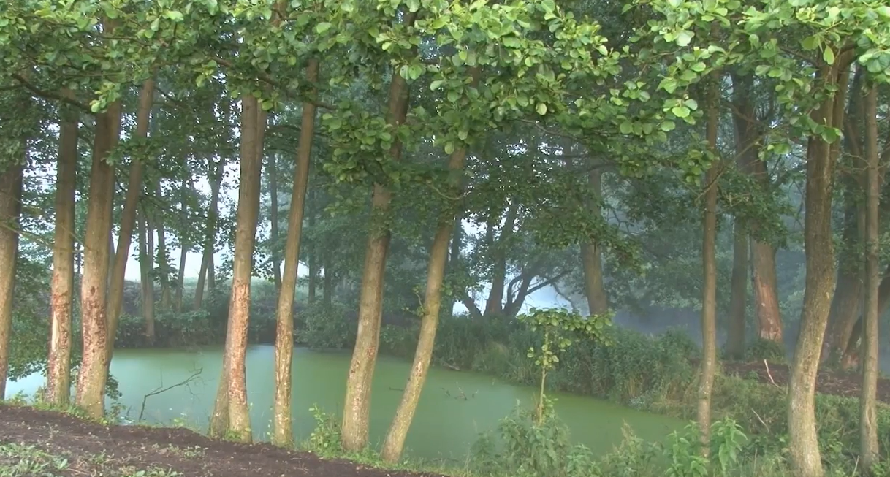

Slide 6
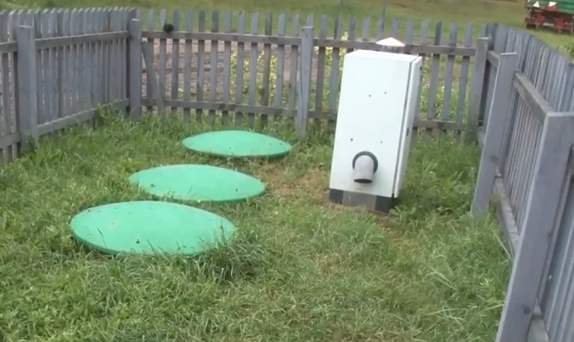
Other technical solutions
applied on the farm
The farm also has a 40-bed facility with guests all year round. It has:
a domestic biological wastewater treatment plant – the clean water is drained to the meadows and pastures distributed by a drainage system – once in a while, the sediment is disposed of;
a biomass-fired central heating system;
solar collectors; and
plans for future – photovoltaics and heat pumps.

Slide 7
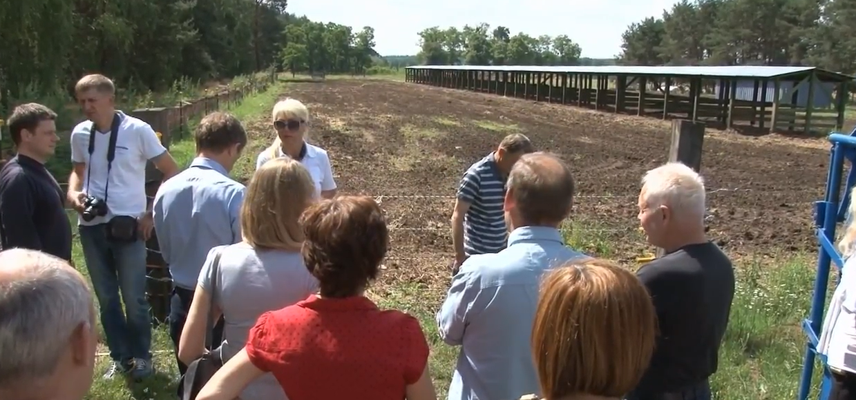
Achievements of the farm
In 2014 it won second place in the national competition of the Ministry of Agriculture and Rural Development for the “Best Organic Farm” in the category “Commercial Organic Farming”
In 2015 it won the national competition “Baltic Sea Farmer of the Year” organised by WWF
It became one of 48 demonstration farms within a network of demonstration farms in Poland promoting good practices friendly to the Baltic Sea – training sessions and meeting for farmers and agricultural advisers are organized there to demonstrate closing the nutrient cycle in agriculture
A film presenting the farm was made by NRN as a good tool for transferring knowledge and promoting pro-environmental attitudes

Slide 8
Dissemination of good practice
Film on cattle breeding carried out in a Baltic-friendly manner as a standard of closing the nutrient cycle on the farm, was disseminated through:
emissions in TVP in September, October, November, December 2017,
published on You Tube Centrum Doradztwa Rolniczego w Brwinowie (https://www.youtube.com/user/CDRBrwinow/videos)
distributed in 1200 copies of CD among Agricultural Advisory Centres and Voivodeship Agricultural Advisory Units

Slide 9
You are welcome to see shorter version of the film with English subtitles
https://www.youtube.com/watch?v=5HVJzB4GUV8

Slide 10
Thank you
National Rural Network Division
Agricultural Advisory Centre in Brwinów
Warsaw Branch Office
a.markuszewska@cdr.gov.pl
www.ksow.pl

