Slide 1
Forum of LAGs Podlaskie Region
ENRD LAG Implementation Survey 2017
John Grieve,
ENRD Contact Point
22nd March 2018

Slide 2
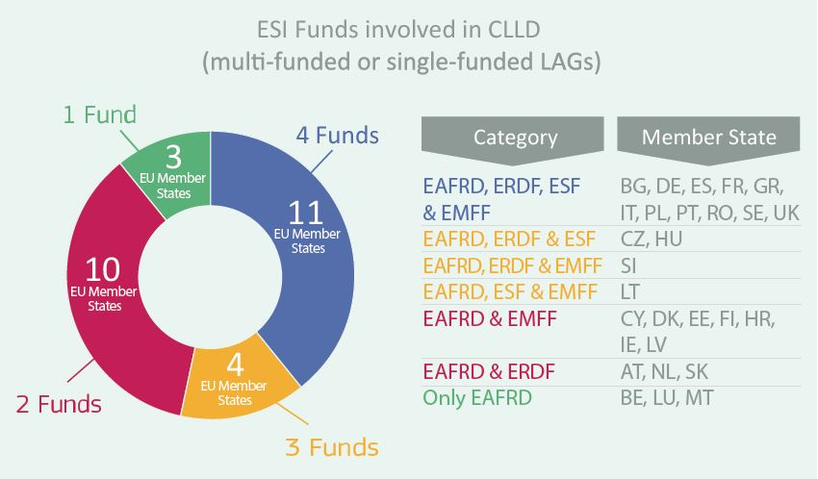
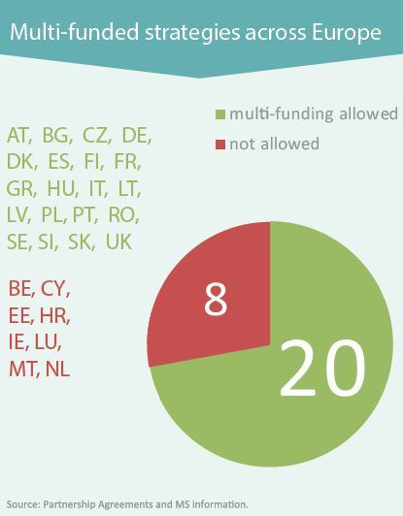
How CLLD was programmed
Source: DG Agri, Partnership agreements

Slide 3
State of play: October 2017
CLLD implementation in the MS
Various combinations
Mono-funded strategies
Financed only with one fund
Multi-funded strategies
Integration of various Funds
EAFRD
EMFF
ERDF
ESF
ERDF
ESF
EAFRD EMFF
Other ESIF combinations
Rural LAGs
FisheryLAGs
Urb/Rur LAGs
Urban LAGs
Urban-Rural
LAGs
Rural-Fishery
LAGs
Rur/Urb/Fish
LAGs
1.989
271
21+4
45
159
69
498
2.330 Mono-fund LAGs
726 Multi-fund LAGs
2.260 Traditional approach
796 New approach
229 Under ERDF/ESF
Current total: 3.056 LAGs
Notes:
Sources:
EAFRD
DG Agri, 02/2017
EMFF and EAFRD/EMFF
FARNET, 09/2017
ERDF & ESF
Own Expert assignment, 08/2017
Numbers have moved on, 2492 on database of whom 2346 are EAFRD funded, next stage will allow identification of multifund, it is underreported but possibly overestimated here

Slide 4
Basic data
#LeaderCLLD

Slide 5
Basic Data – Make up of Responses
LEADER implementation 'on the ground’ - LAGs’ viewpoint
710 responses from 27 Member States
19 National and 70 Regional RDPs
72% responses came from LAG managers
22% were ‘new’ LAGs, 44% LEADER I – LEADER+
59% selected by end 2015, 10% in 2017
67% had launched calls by end of 2016
32% used two or more funds (60 EMFF, 109 ESF, 177 ERDF)
#LeaderCLLD
Notes:
Focused on:
Basic Data
LEADER Principles
LEADER Operation
LEADER Improvements
Country Info for Poland
28 (10%) of Polish LAGs responded
50% from 2007-13 period
75% established in first half 2016
86 % LAGs who responded were mono EAFRD funded
Germany (143), France (86) and Spain (83)
Cyprus, Luxemburg 100% (but low number of LAGs overall in these MSs), Latvia 66%, AT 67%
Top 3 National – CZ (53), AT (43), PL (29)
Top 3 regional – UK_Eng (29), DE_Neidersach/Bremen (27), ES_Andalucia (27)
1 National and 20 regions did not respond
National – SK, Regional ES (3), FR (7), IT (10)
New LAGs in general were selected at an earlier stage than ‘older ones’ 69% of new 2014-2020 LAGs were selected by end 2015 and 29% had launched calls
40% of former LEADER I LAGs were selected and 20% had launched calls by end 2015

Slide 6
Basic Data – Funding
18%
44%
Notes:
75% of Polish LAGs who responded has between €1.5-4m budgets
46% of Polish LAGs spent 17-20% on animation and admin – although responses spread across the whole range <10 up to 25%
This slide shows the range of budgets of the LAGs that responded to our survey 696 in total – it shows that the largest number of LAGs 44% have budgets between €2-4m
6% have budget <€1m, 2% budget > €10m,
Highest % of large budgets were seen in LEADER I LAGs
Highest % of low budgets were seen in new LAGs
The different colours in the columns show the percentage of the budget that is used for animation and administration in each budget range
11% of LAGs <10% budget for animation & admin;
64% between 17 and 25%
Those between €4-5m highest number using 21 – 25
44% LAGs<€500k spent less that 10% on admin and animation
18% of LAGs >€10m spent between 21-25% on A & A

Slide 7
LEADER Principles
#LeaderCLLD

Slide 8
LEADER Principles – Importance
Notes:
All of these principles are important or essential for at least 50% of respondent LAGs. When looking at `essential` and `important` ratings together, 4 principles exceed 80% of the total responses (networking, area based LDSs, local public-private partnerships, bottom-up approach).
Let us look at `essential` ratings only. The no.1. principle for LAGs is the bottom-up approach with decision-making power for the LAGs in relations to the LDS design and implementation (73% of respondent LAGs considered this essential), with local-public partnerships and area-based LDSs also getting `essential` ratings from more than 50% of respondents LAGs (62% and 58%, respectively)

Slide 9
LEADER Principles
Highest priority element of method is ‘bottom up’; lowest is the 49% rule (which is designed to protect the bottom up principle?)
Public private partnerships and area based local development strategies are elements most fully implemented
Cooperation and innovation are most difficult to implement
80% indicate their ability to implement LEADER approach constrained by bureaucracy, 78% for project implementation
Over 50% believe that finding innovative solutions is either important or very important but is difficult to achieve
LEADER’s ability to directly address local issues is seen to be important and achievable
Notes:
PL – same priorities as 1, 2
3 – ino and coop difficult – also networking of local partners
4 – same issues 62.5% and 52%
5 – 95% very/important and difficult to achieve inno solutions
83% - very/important and difficult
Directly addressing local issues and opportunities – direct opposite of point 6 on slide
Strengthening stakeholder participation in local partnership and its governance.
Strengthening economic linkages among local actors.
Strongest (82%) v/imp & achievable – cooperating with other LAGs

Slide 10
LEADER Principles – Practice
Notes:
To start on a positive note, the results clearly indicate that LAGs are able to implement the elements of the LEADER approach – there is a relatively low % of `slightly` and `not at all` responses.
Notice that even though the bottom-up approach was clearly the most `essential` and `important` principle, for this question, it is only no.3. if we examine the `fully` and `mostly` responses. While 73% of LAGs considered this essential, only 48% of LAGs can implement this fully.
There is apparently a challenge with implementing cooperation projects and innovative approaches – with less than 60% of LAGs being `fully` or `mostly` able to implement these.

Slide 11
LEADER Principles – Importance and Achievability
Notes:
At the two extremes of `difficult` or `achievable` and important/very important – represented by >60% of LAGs selecting these options – are:
Finding innovative solutions to local problems – considered difficult by >60% of LAGs, in fact twice as many LAGs think it is difficult, than `achievable`; and
Cooperating with other LAG territories – with 67% of LAGs saying it is achievable and 28% of LAGs saying it is difficult
Other `difficult` elements – more than 50% of LAGs think they are `difficult` - include mobilising local resources, improving local social capital and cohesion, strengthening economic linkages among local actors.
Overall, about 2/3 of LAGs think it is `achievable` to directly address local issues and opportunities.

Slide 12
LEADER Operation
#LeaderCLLD

Slide 13
LEADER Operation – Changes Since 2007-2013
Notes:
When looking at this diagram, one item immediately stands out. That is the level of Managing Authority/Paying Agency conditions and reporting requirements which have `increased` or `significantly increased` since the 2007-2013 programming period. While LAG autonomy seems to have increased – overall – in LDS design, considering LDS implementation it has clearly decreased for more LAGs (for 33% of respondents). LAG freedom to develop innovative solutions also decreased – for 37% of LAGs.
25% of LAGs appear to have increased their involvement in other regional and territorial development actions or structures, and LAG member involvement in LDS implementation appears to have increased for 26% of LAGs (and decreased only for 8%). This may or may not be related to the increased level of activity, but the proportion of non-public partners also increased for 30% of LAGs. These increases constitute positive development overall.

Slide 14
LEADER Operations
Continuity of LAG membership rates as important
Negative effects on implementation
MA/PA conditions/reporting requirements (71%)
Time taken to approve selected projects (68%)
Implementation procedures aimed at reducing risk rather than encouraging innovation (61%)
Over 40% find level of MA conditions and reporting more or significantly more than before
Notes:
For PL
1 – highest possibility of multi funding, followed by increase in funding for LEADER
3 –
63% see increase in MA conditions and reporting more than before
62% have seen increase in LAG population
50% seen increase in number of FTEs
Point 2 Negative effects
77% Effects on local decision-making of final approval of projects by the MA/PA
73% Implementation procedures which aim to reduce risk rather than encouraging innovative solutions.
73% Level of Managing Authority /Paying Agency conditions, reporting requirements.

Slide 15
LEADER Operations
70% of LAGs chose ‘local economy (non-agriculture), job creation’ as theme relating most closely to their LDS objectives
‘Broadband, internet, ICT` was least preferred option with only two LAGs choosing it as their first option
LAG staff spend more time on supporting projects than financial management and admin –these are the top two – LAGs most want to spend more time on project support
Notes:
In Poland
87% LAGs chose Local Economy
0% chose Broadband ICT
Top time spent day to day in PL
Supporting project development and implementation - overall 52%
Animation, capacity building and training of local stakeholders (inc. LAG members) 48%
73% LAGs want to spend more time on ‘Animation, capacity building and training of local stakeholders (inc. LAG members)’

Slide 16
Importance of Operational Priorities to LAGs
Notes:
Clearly, the top of the rank is `achieve LDS objectives` - more than 350 LAGs selected it as the 1st, 2nd, or 3rd most important operational priority for them. Apparently, LDS implementation – for the majority of LAGs at least – is not about maximising the number of projects supported or the budget spent, but more about achieving LDS objectives (also possibly through these means).
Actually, if we look at the top-3 – or 4 – operational priorities for LAGs, they all relate to local development, local solutions, capacities. These top-4 operational priorities have been selected by more than 200 LAGs each.
At the other end of the range, three operational priorities – avoiding risk, cooperation with partners outside the LAG territory, and ensuring that the LDS contributes to the RDP – were selected as 1st, 2nd, or 3rd in the rank by less than 50 LAGs (less than 5 LAGs ranked these 1st !)

Slide 17
LEADER Operation
The top operational priority for LAGs is to achieve the objectives of their strategy but only 13% consider they have sufficient freedom to do so
Almost 50% of LAGs perform only the `project selection` function, 18% do selection, approval and payment of claims.
Most asked for improvements:
Simpler project applications
Better common knowledge through networking
Improving MA/IB turnaround time were the top 1 & 2 requests and eligibility of measures to support new ideas,
Notes:
PL –
1. PL top opperational priority to achieve LDS objectives – 9% consider they have sufficient freedom
2. 57% project selection only and 26% - do selection, approval and payment of claims.
3. PL Improvements
Stand out – 86% Improving MA or intermediary body turnaround time on approving selected projects.
50% - Simpler project application forms/application process.
36% - Improving timeliness of payments of beneficiaries` claims.
36% - LAGs using qualitative criteria and local knowledge to inform project selection decisions.
Overall least important improvements were seen to be support on delivery tools, clarity on M&E and dedicated EU/National platform, however the LAGs setting selection criteria and defining calls and allocating resources for cooperation were the least important individually

Slide 18
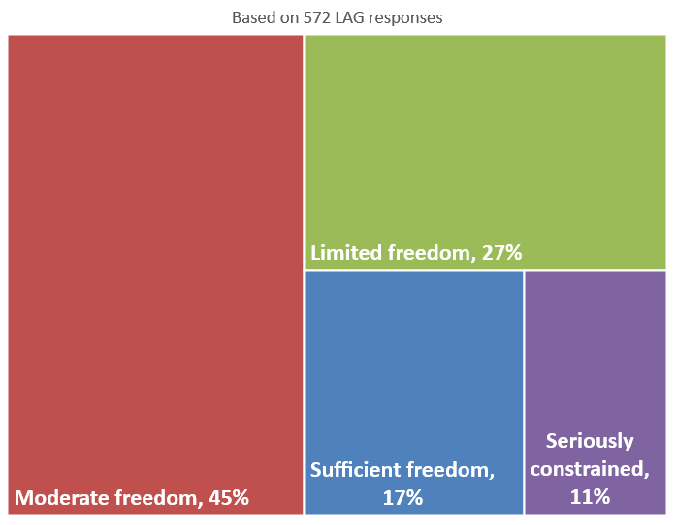
LAG freedom to pursue operational objectives within the current national/regional delivery framework
Notes:
In the experience of 83% of LAGs, the current national/regional delivery framework represents some degree of limitation of their freedom to pursue their operational objectives. This means that only 17% of LAGs have `sufficient freedom` to pursue their operational objectives. Compare and contrast this with what we have demonstrated so far – that for LAGs the core of their work is focused on local development and their most important operational objective is `achieving LDS objectives`.

Slide 19
LEADER Improvements
#LeaderCLLD

Slide 20
LEADER Improvements Independence, Responsibility and Achievement
Notes:
20 % are happy with the – same level of responsibility and independence that the have at the moment - status quo
You can see from the Orange and green that there is an appetite for both moderate (grey) and mich higher (orange) levels of indi and responsibility
24% (green) do not think that increasing independence should be linked to increased LAG responsibility
LAGs were also asked to what extent greater power, independence and responsibility would improve what you are able to achieve:
78% of LAGs thought that it would increase achievement, with
54% thinking it would either significantly or very significantly improve achievement
Only 12% thought there would be no improvement
PL – increase in independence and responsibilty
18% Status Quo
14% Much higher in both
27% Moderate in both
5% Less independence / lower responsibility
27% Existing independence / lower responsibility
9% Don't link the two
Pl Increase in achievement with more indi and respons
5% Not at all
32% A little
59% Significantly
5% Very significantly

Slide 21
LEADER Improvements
64% LAGs think centralising admin would increase levels of achievement
Smallest gaps in MA/PA and NRNs support is for animation and networking
Greatest gaps and support needed in ‘ensuring better understanding of audit expectations’
LAGs would like support from ENRD in implementing simplified cost option, networking and cooperation and working with other funds
Notes:
37% who thought centralised support would significantly or very significantly improve achievement (green and purple)
Maybe not surprisingly it was the LAGs with the smaller budgets (€1m and under) that thought that centralised admin would improve achievement –50%
although interestingly of the 53% LAGs that responded to our survey with budgets of €4-5m also thought it would improve achievement
When looked at by age of LAG - LEADER II LAGs were the only ones that chose ‘centralised admin would significantly improve admin’, all others had not at all for first choice
PL
64% don’t want centralised admin at all
Smallest gap MA/PA – improving understanding of RDP measures
Smallest gap NRN Cooperation
Greatest gap MA/PA – audit requirements
Greatest gap NRN - Understanding LEADER linkages to other RDP measures
Top 3 ENRD support
Simplified cost option
LAG financial and administrative management of LDS implementation.
Strengthening the role of the LAG locally.

Slide 22
LEADER Improvements
LAGS least favoured options for support from ENRD were LAG self assessment, LAG reviews of LDSs and support for animation and participation
Increased participation in ENRD work would be helped most by more available time, higher LAG budget and more flexible rules related to travel.
NRN support, more language versions and less costly methods of participation scored lowest in preventing participation
Notes:
PL responses
Zero LAGs waned support on self assessment form ENRD
Higher LAG budget to way could inc participation in ENRD, more time, access to additional support for participation in events
More language versions of ENRD documents, More information from the NRN on ENRD activities. NRN support’ Less costly methods of participation scored lowest in

Slide 23
LEADER Improvements - ENRD Involvement
Notes:
Q33 – ENRD
1. Simplified cost option the most requested
Large number of LAGs in DE-62, AT-25, CZ- 24
Big spike in demand from LAGs in €2-3m and €3-4m budgets
2. LAG financial and administrative management of LDS implementation
3. Networking and cooperation
If look at 1 & 2 together - Strengthening innovation in LEADER comes out strongly

Slide 24
LEADER Improvements
Notes:
71% LAGs think self assessment essential /important, 19% completed by end 2017, 48% expect to do it in 2018
PL 67% self assessment is important/essential, 64% expect to do it in first half 2018

Slide 25
ENRD Consultation and Facilitation of LEADER / CLLD
Two Practitioner-Led Working Groups (PWGs)
Cooperation
Innovation
ENRD Workshop on LEADER Innovation, Brussels
ENRD Workshop on LEADER Simplification, Brussels
Third EU Seminar on CLLD, Gyor, Hungary
LEADER Reflection Group

Slide 26
Summary Points
Coherent & consistent communication in delivery chain
Demonstrate added value of LEADER, ensure common understanding in delivery chain
Enable LAGs to focus more on animation, project support & development
Enhance SCO use for simpler delivery & reduced admin burden
Make sure all LEADER stakeholders learn from controls & audits
Simplification - moving forward together at the MS level (involving MAs, LAGs, NRNs, PAs in finding good solutions)
Modifying Member State’s existing delivery systems to improve LEADER delivery and results
Enable LAGs to exercise operational & strategic freedom for better LDS delivery
Notes:
Main points, these are about now and what can be done.

Slide 27
Thank you for your attention!
www.enrd.ec.europa.eu
ENRD Contact Point
Rue de la Loi / Wetstraat, 38 (bte 4)
1040 Bruxelles/Brussel BELGIQUE/BELGIË
Tel. +32 2 801 38 00
info@enrd.eu

