Slide 1
CLLD in Sweden
Information from LUS
Association for Local Development Sweden

Slide 2
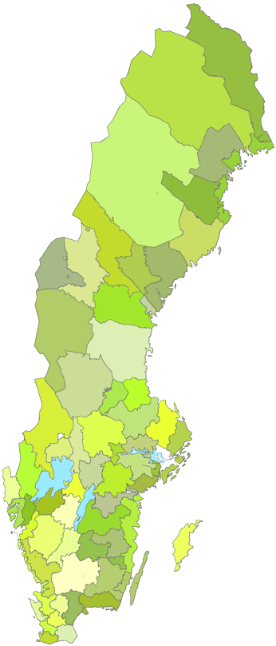
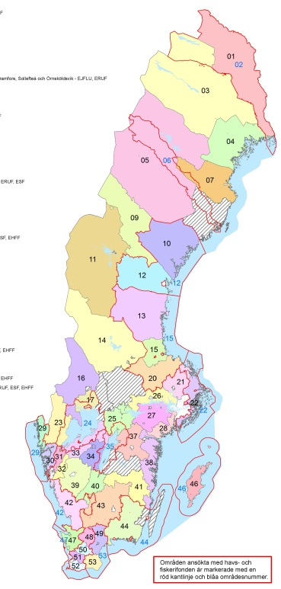
The evolution of Leader in Sweden
1995 > 2001
12 LAGs
EXPERIMENTAL
?
2020
WORKING FOR: LESS REGULATION AND MORE AUTHORITY
2001 > 2008
12 LAGs (new!)
EXPERIMENTAL
2007 > 2013
63 LAGs, 14 FLAGs
99% of the rural area
MAINSTREAMING
2014 > 2020
48/53 LAGs
93,4% of rural area
MULTIFUNDED

Slide 3
Model with intermediate body
EU
ERDF 6%
16,5 mio €
ESF 16,3 mio €
EMFF
16,6 mio €
EARDF
5%
200 mio €
Board of agriculture
CLLD-unit with 10-15 co-workers takes the task of MA
PA at different unit

Slide 4
The funds and the CLLD-areas
8 areas with 4 funds
28 areas with 3 funds
27 EARFD, ESF and ERDF,
1 EARFD, EMFF and ERDF
6 areas with 2 funds
4 EARFD and ERDF
2 EARFD and ESF
6 areas with 1 fund
4 EMFF,
2 EARFD
5 areas without funding

Slide 5
Remarks from LUS
Positive
Great with 4 funds!
Great with the intermediate body!
Possibility to have dialogue with MA & PA at one time
A strong strategic will from MA and PA to streamline the infomation and rules
Negative:
Stronger control of the projects and the LAGs – more rules and regulations
E-application not adjusted for the leaderapproach
”One size fits all” - approach
SCO rather for the board of agriculture than for Leaderareas or our applicants
Less funding– 5 areas completely without funding
Our Goal:
2020 with less rules and more authority for the LAGs
More focus on capacity-building than rules and regulations

